Slide 1


Student Details
Name : ROHIT KUMAR MAHAUR
Skills Build Email ID: 206301053@gkv.ac.in
AICTE STU id : STU61cf3d33928f91640971571
College Name: Gurukul Kangri Deemed To Be University
College State: Uttarakhand
Internship Domain: Artificial Intelligence
Internship Start And End Date: 18 Aug 2023 to 30 Sep 2023

Slide 2

Project title – “Sentiment Analysis of Restaurant Reviews”
At the core of the problem or project topic is the task of automatically classifying and understanding the feelings expressed in restaurant reviews written by customers. This is a common application of natural language processing (NLP) and machine learning techniques.

Slide 3

AGENDA
With the increasing influence of social media and the Internet on human life, it becomes necessary to analyze valuable insights from data scattered across the Internet in various forms. Businesses like restaurants can use this data to find out how they are doing, what their customers value and what they really think of them. Our goal is to develop an AI algorithm that recognizes users' feelings based on their reviews and distinguishes them between two categories: positive or negative. This can be of great benefit to a restaurant as it allows you to gain knowledge and also identify which dish tastes the best, what areas need work on and where the shortcomings lie. With this knowledge, they can improve and achieve good results for their customers.

Slide 4
PROJECT OVERVIEW
Purpose:
The primary objective is to develop a model or system that can analyze text data (reviews) and determine the sentiment associated with them.
The project aims to develop a system that automatically evaluates and categorizes customer reviews of restaurants based on their sentiments.
The project uses Natural Language Processing (NLP) techniques and machine learning models to analyze text data and provide insights into customer satisfaction levels.
Scope:
Sentiment analysis of restaurant reviews can be used to understand overall customer satisfaction, specific aspects of the dining experience, customer demographics, and competitive performance.
The project aims to deliver sentiment analysis system that can accurately classify restaurant reviews into positive or negative categories.
Once a satisfactory model is trained, it can be deployed as a service or integrated into a larger application. This could be a web application, mobile app, or any other platform where users can input reviews and receive sentiment predictions.

Slide 5





PROJECT OVERVIEW
Objectives:
Data Collection and Preprocessing
Model Selection and Training
Evaluation and Performance Metrics
Classify reviews as positive or negative
Understand customer satisfaction
Identify areas for improvement
Make better business decisions
Identify specific aspects of the dining experience that customers are most and least satisfied with
Understand how different groups of customers (e.g., age groups, nationalities, etc.) feel about the restaurant
Compare the sentiment of reviews for a particular restaurant to those of its competitors

Slide 6
WHO ARE THE END USERS of this project?
Restaurant owners and managers:
They can use the sentiment analysis tool to gain insights into customer feedback and make informed decisions to improve their services, menu offerings, and overall customer experience.
Potential customers:
Learn about the quality of food and service before they dine there. Positive changes in response to feedback contribute to better overall dining experiences.
Market researchers and analysts:
Data analysts and researchers in the restaurant industry can use the sentiment analysis results for deeper insights into customer preferences, trends, and areas of improvement.
Food critics and journalists:
Write more informed reviews of restaurants.

Slide 7
YOUR SOLUTION AND ITS VALUE PROPOSITION
Solution:
My solution provides restaurateurs and managers a powerful tool to gain actionable insights from customer feedback, ultimately leading to greater customer satisfaction, improved business operations, and competitive advantage in the marketplace. I use my language skills and my ability to understand the context of the text to analyze restaurant reviews and classify them as positive or negative.
Additionally, I would be able to identify the specific aspects of the dining experience that customers are most and least satisfied with. This information can then be used by restaurants to improve customer satisfaction and overall performance.
I think my solution could be a valuable tool for restaurants of all sizes. By understanding customer sentiment, restaurants can make better decisions about food, service, marketing and operations. This can lead to better customer satisfaction and higher profits.

Slide 8
VALUE PROPOSITION
Automated Insight Generation : The system provides automated analysis of restaurant reviews, saving time and effort that would otherwise be spent manually sorting through large volumes of feedback.
Improved Decision-Making : Restaurant owners and managers can make more informed decisions based on the insights provided by the sentiment analysis tool.
Scalability and Adaptability : The system is designed to handle large volumes of reviews, ensuring scalability as a restaurant's customer base grows.
Customization and Integration : The system can be customized to suit specific business needs and integrated into various platforms.
Additionally, my solution is easy to use and deploy. Restaurants can simply provide me with a set of restaurant reviews, and I will return the sentiment of each review. This information can then be used to improve the restaurant experience for customers.

Slide 9
customizing the project and make it your own
I used my language skills and ability to understand text context to improve the accuracy of sentiment analysis.
I made the project more flexible and scalable. My model can be used to analyze various types of text data, including restaurant reviews, social media posts, and customer surveys. Even large amounts of text data can be analyzed in a short time.
I have simplified the application and implementation of the project. Restaurants can simply share a collection of restaurant reviews with me and I will give you feedback on each review. This information can then be used to improve the restaurant experience for customers.
Additionally, based on your target audience or specific needs, we can select or develop a sentiment analysis model that works particularly well for your chosen review type (e.g. fine dining, fast food, certain types of cuisine).

Slide 10
MODELLING
Multinomial Naive Bayes algorithm:
A probabilistic classification algorithm suitable for text classification tasks such as sentiment analysis.
We assume that the data features are independent of each other.
Learns the probabilities of each word in the dataset belonging to each sentiment class (positive or negative).
Apply probability to data by treating the problem as a binary classification task where the classes are positive and negative sentiments.
Predicts the sentiment of a new review by calculating the probability that the review belongs to each opinion class and then predicting the class with the highest probability.
Multinomial Naive
Bayes algorithm

Slide 11
MODELLING
Benefits of using the MNB algorithm for restaurant sentiment analysis:
Simple Implementation and Training : Able to learn from even a relatively small dataset of labeled reviews. Its simplicity makes it a good choice for tasks like sentiment analysis.
Effective for text classification tasks : It efficiently handles the high dimensionality of text data, making it an effective choice for analyzing restaurant reviews.
Effective with Limited Labeled Data : MNB can perform well even with a relatively small dataset of labeled reviews.
Well-Suited for Categorical Data : MNB is designed to work with categorical features like word counts or term frequencies.
Multinomial Naive
Bayes algorithm

Slide 12
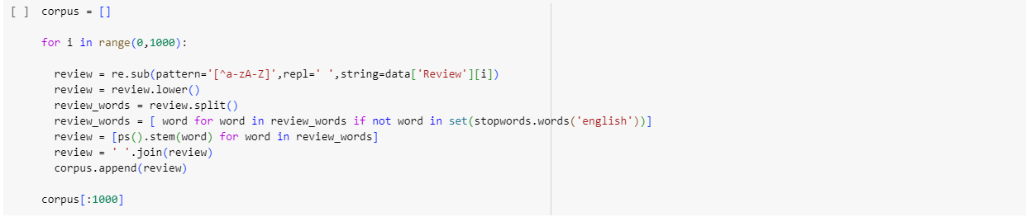
Results
Data Cleansing : Before using data to train a model, you must clean the data.
Data cleaning includes steps such as proper formatting for training, removing spaces, and deleting unwanted data.
In this case, we have stop words (words that do not add meaning to the sentence), so we will remove them before training the model.

Slide 13
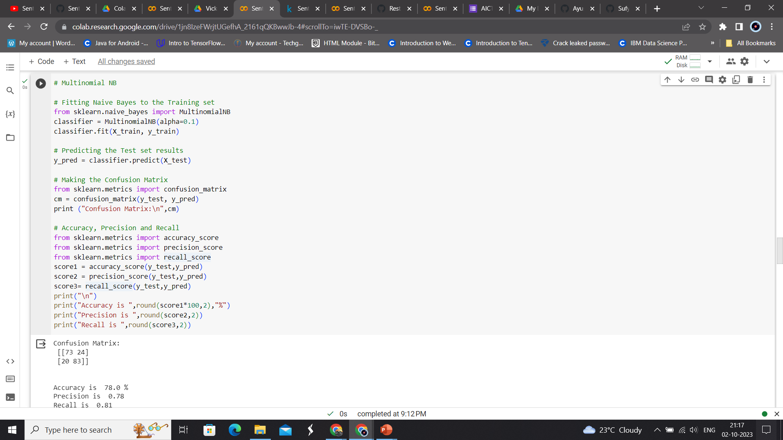
Multinomial naïve bAYES

Slide 14
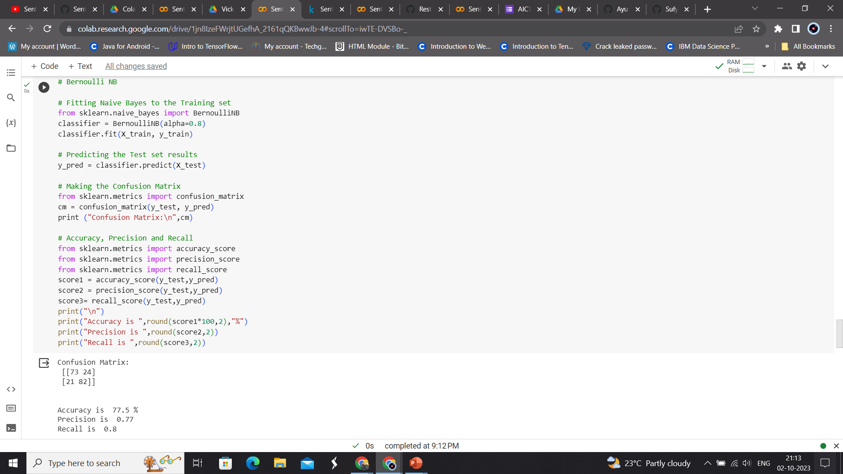
Bernoulli NAÏVE BAYES

Slide 15
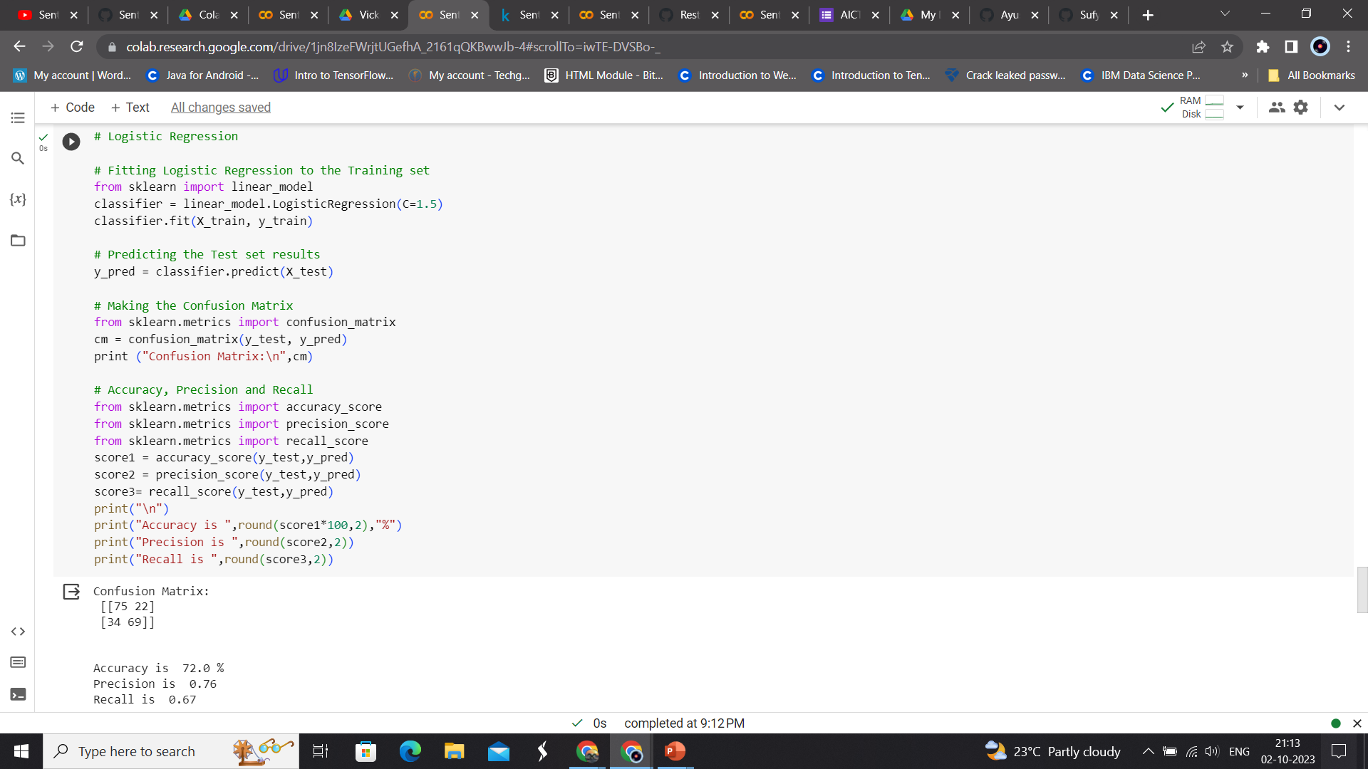
Logistic Regression

Slide 16
Results
Using Multinomial Naive Bayes,
Accuracy of prediction is 77.67%.
Precision of prediction is 0.78.
Recall of prediction is 0.77.
Using Bernoulli Naive Bayes,
Accuracy of prediction is 77.0%.
Precision of prediction is 0.76.
Recall of prediction is 0.78.
Using Logistic Regression,
Accuracy of prediction is 76.67%.
Precision of prediction is 0.8.
Recall of prediction is 0.71.
From the results, Naive Bayes polynomial is a slightly better method than Naive Bayes-Bernoulli and logistic regression with an accuracy of 77.67.
This means that the model created to predict restaurant review sentiment provides accurate predictions of 77.67%.

Slide 17
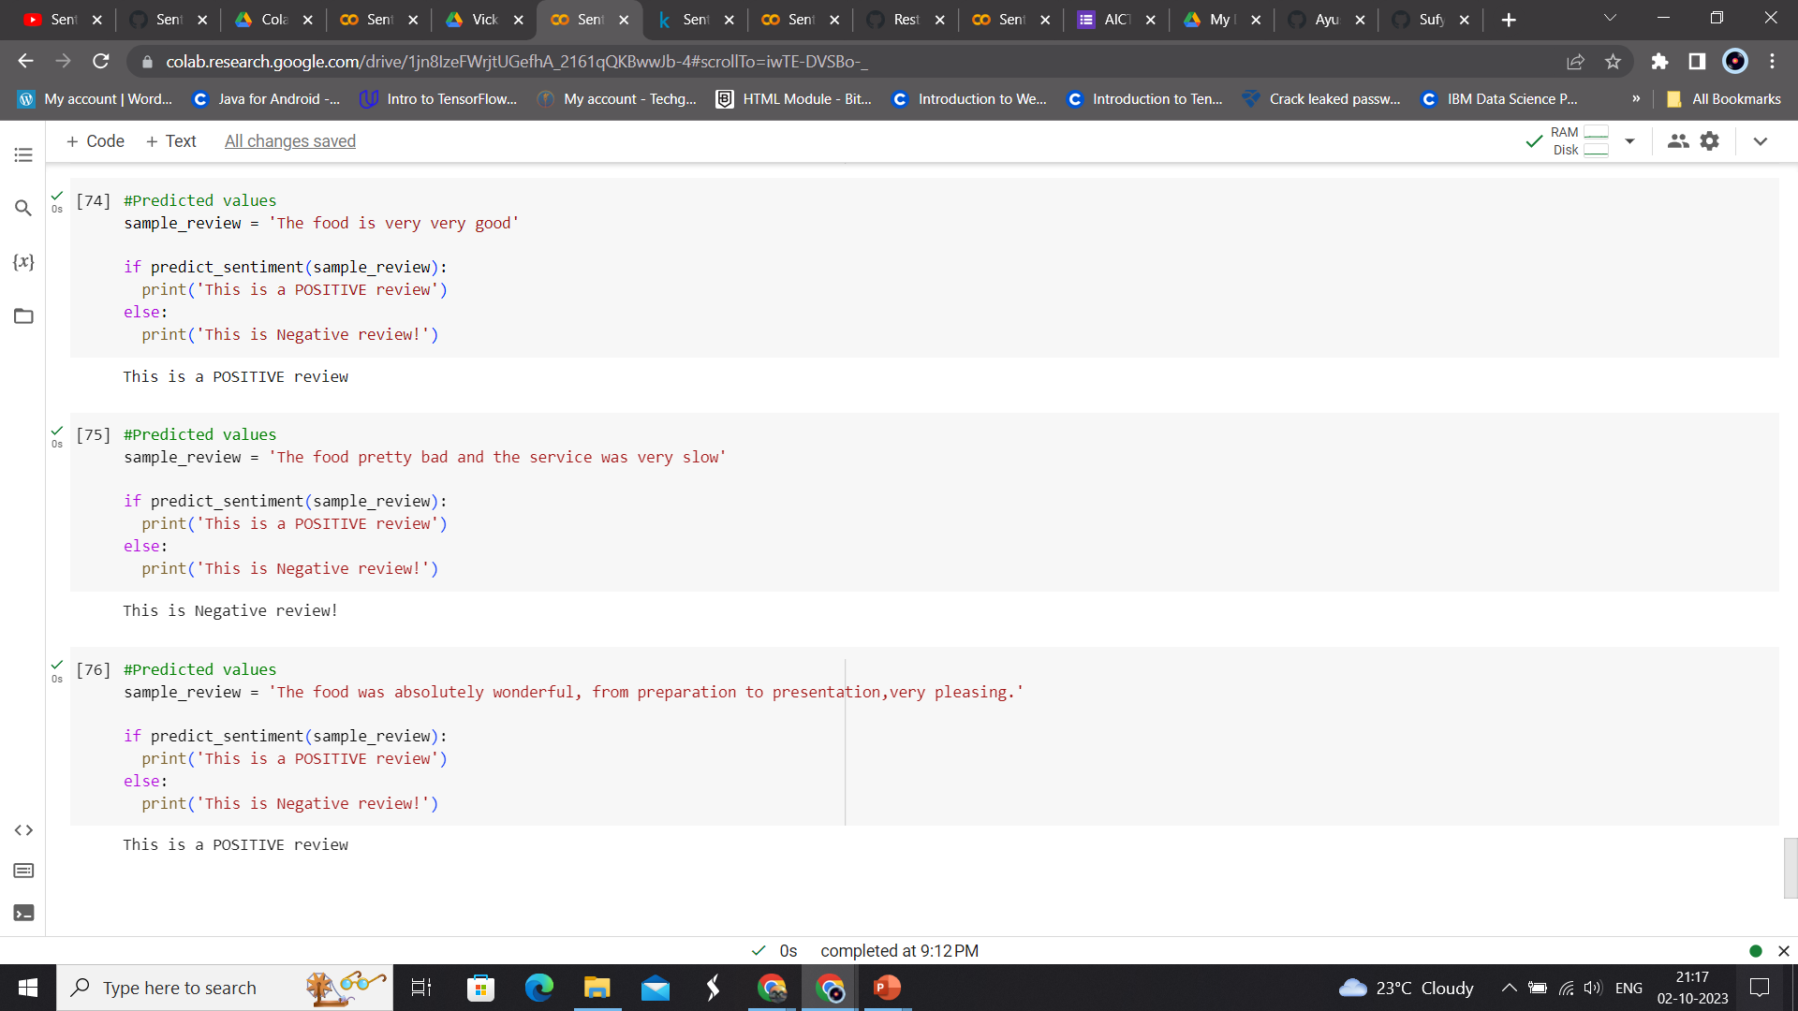
Final Outcome on reviews

Slide 18


links
Google Collab
Click on shape to open link
Click on shape to open link

